Slide 4
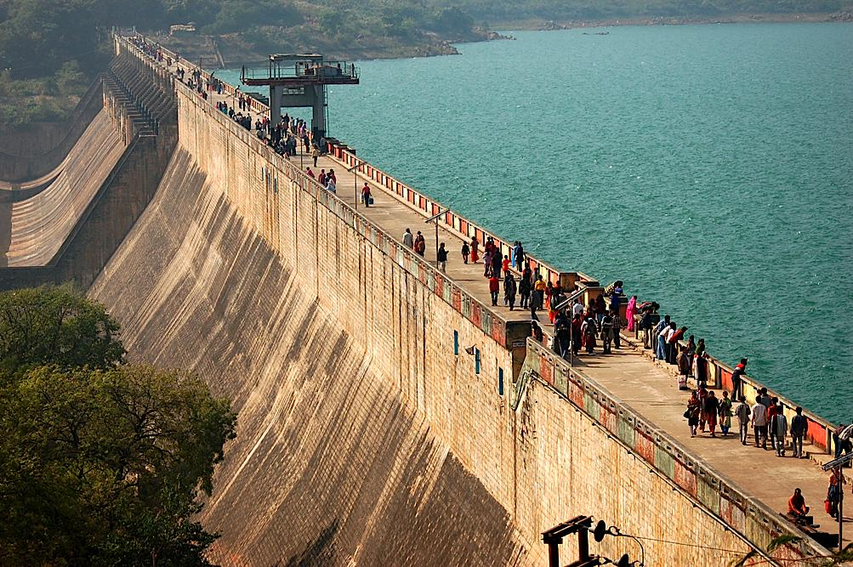
Controlling Floods
Dams – structures built across a river to control its flow
A dam can be opened to let some water through
Dams hold back floodwaters at times of heavy rainfall
http://www.dameffects.org/
© LoveLearning 2014

Slide 5
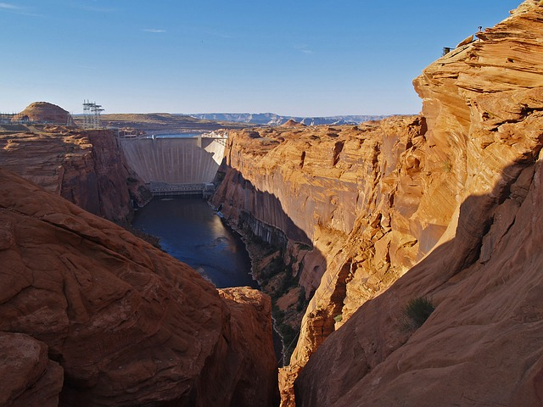

Slide 6
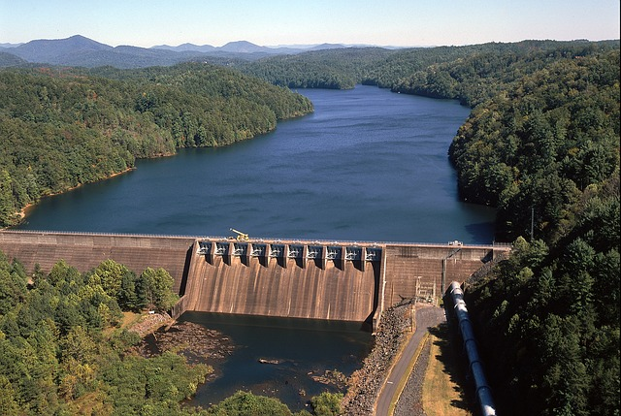

Slide 7
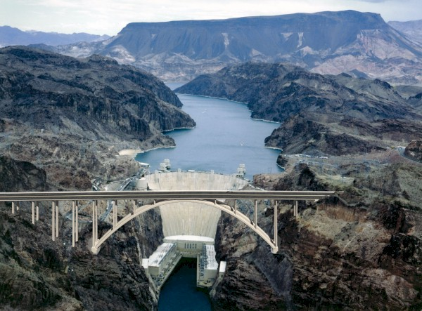
Controlling Floods
Dams also hold back sediment that rivers usually carry
Prevents beaches and floodplains from being formed
http://www.brainpop.com/technology/energytechnology/dams/preview.weml
© LoveLearning 2014

Slide 8
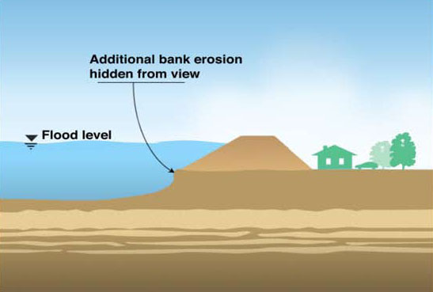
Controlling Floods
Levees also hold back floodwaters
Levee: a raised bank of earth built along the edges of a river to prevent flooding
Only holds back water during high water levels
Sometimes, levees break
© LoveLearning 2014
Notes:
Click on the title for an interactive site that shows Hurricane Katrina’s effect on New Orleans

Slide 10
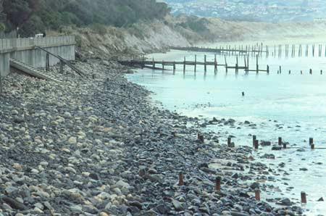
Controlling Erosion
A lot of erosion occurs on coasts (like Georgia’s beaches)
This erosion eats away beach sand and destroys things that are built on beaches
http://www.brainpop.com/science/earthsystem/erosion/preview.weml
People have built structures that prevent erosion
Groins and seawalls
© LoveLearning 2014

Slide 11
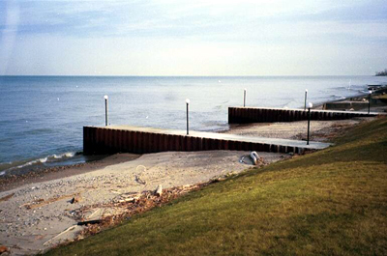
Effects on Destructive Processes
Groins
A structure built at right angles to the beach
Traps sand that moves along the shore with longshore currents
© LoveLearning 2014

Slide 12
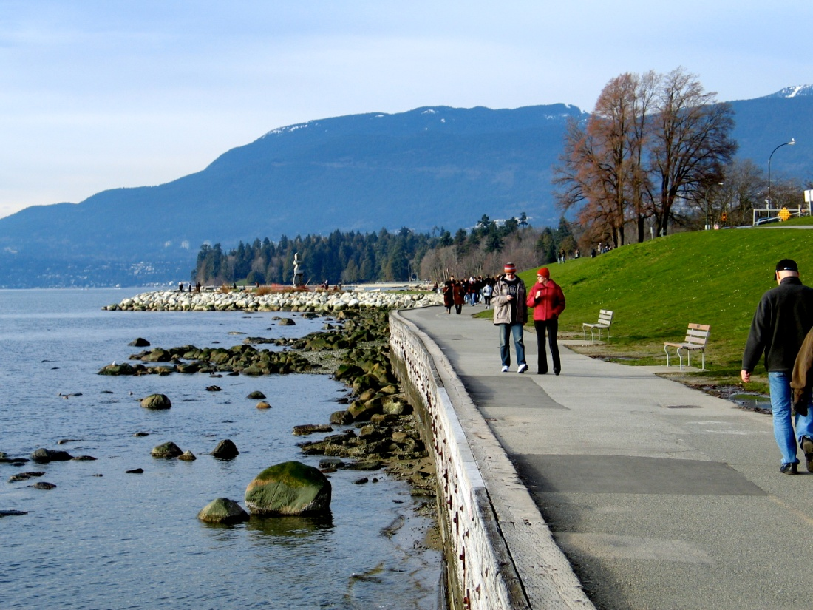
Effects on Destructive Processes
Seawalls
A structure built parallel to the shore
Seawalls absorb the pounding of waves and protects the coast behind it
© LoveLearning 2014

Slide 13
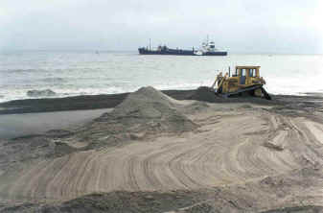
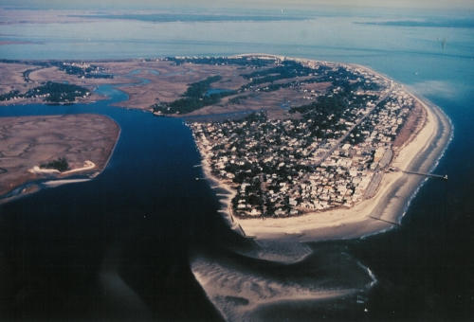
Effects on Destructive Processes
Beach nourishment
When sand from the ocean or nearby rivers is brought in to build up a beach again after erosion has taken place
This has been done at Tybee Island and Sea Island in Georgia
© LoveLearning 2014

Slide 14
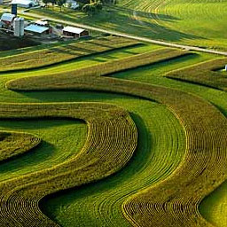
Effects on Destructive Processes
Farmers also use different methods to prevent the loss of soil
Contour plowing
A method in which farmers plow across the sides of hills instead of down their slopes
© LoveLearning 2014

Slide 15
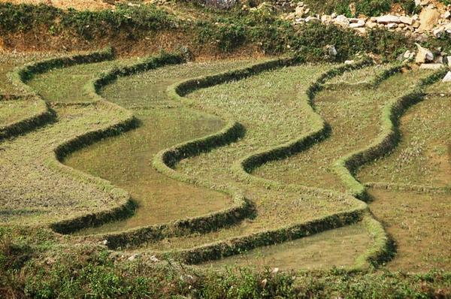
Effects on Destructive Processes
Terracing
A method in which farmers plant crops on terraces built on hillsides
Both contour plowing and terracing prevent soil from washing downhill
© LoveLearning 2014

Slide 16
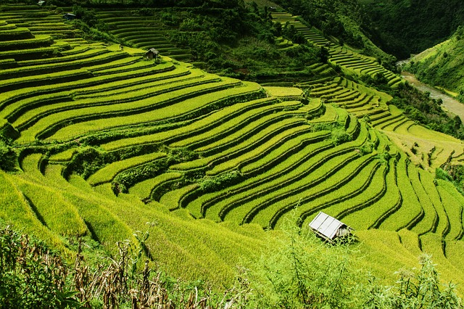
© LoveLearning 2014

Slide 17
Terms of Use
Thank you for downloading this product! The purchase of this product entitles you to single classroom use. Please be respectful of my work and do not share with your entire grade level or post this anywhere online (including your personal website). If you wish to share this with colleagues, please purchase multiple user licenses.
If you have any questions or need clarification, please contact me at lovelearningTPT@yahoo.com
Other science, social studies, common core math, and writing resources

Slide 18
Graphics From:
www.pixabay.com

