Slide 1
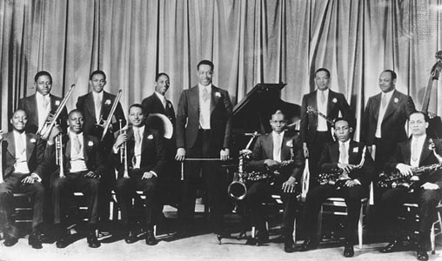
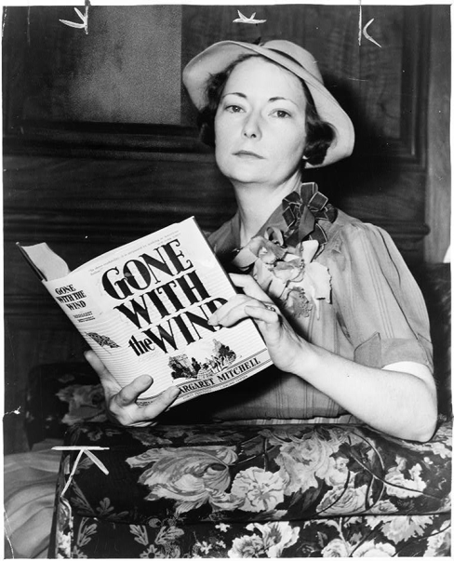
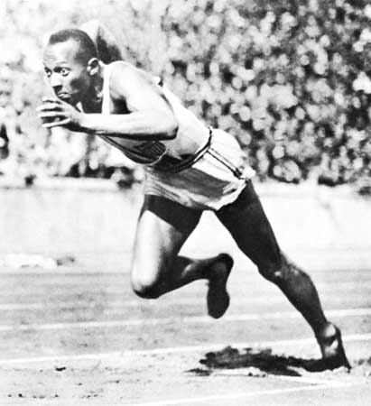
c. Discuss important cultural elements of the 1930s; include Duke Ellington, Margaret Mitchell, and Jesse Owens.

Slide 2
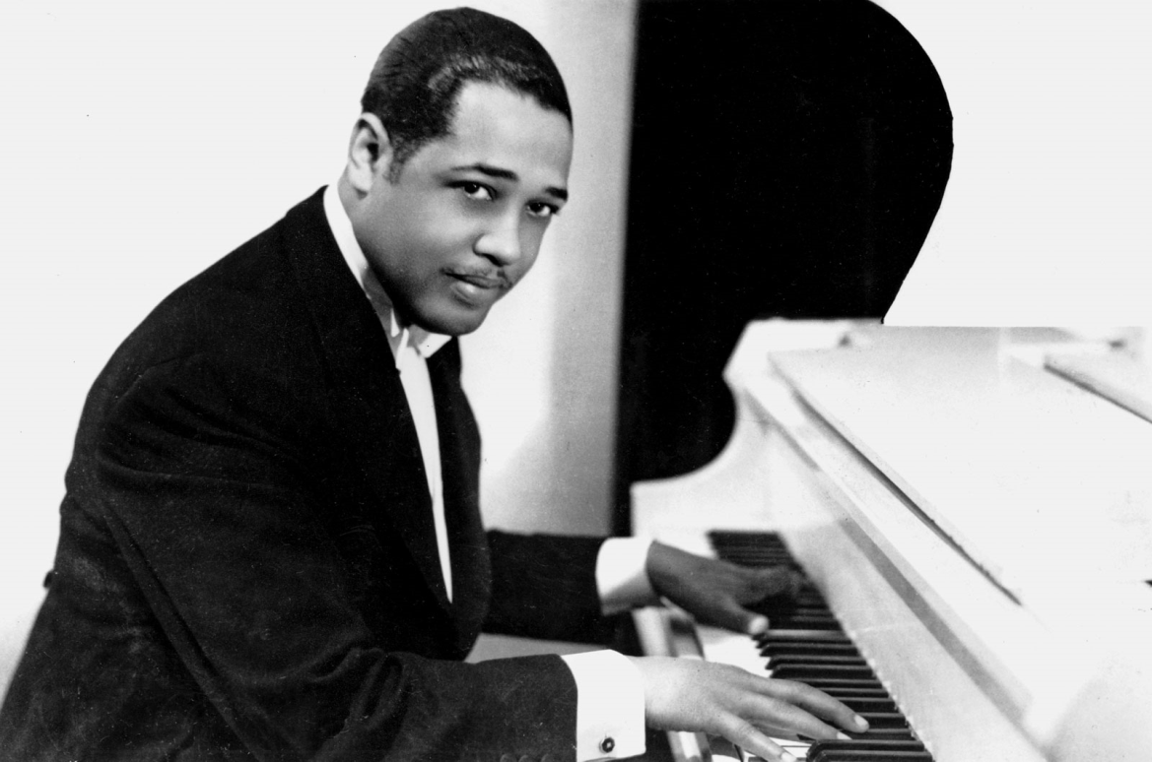
Duke Ellington
Ellington was a composer and was one of the most famous “swing” musicians ever. Swing was a type of dance music which was very popular during the Great Depression.
Ellington and his band traveled all over the world.
Click on the photo of Duke Ellington to see he and his band in action (1943)!

Slide 3
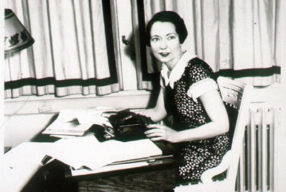
Margaret Mitchell
Famous author during the Great Depression
Wrote Gone With the Wind-sold a million copies in six months. Was a story about a Georgia family who overcame hardships before, during, and after the Civil War.

Slide 4
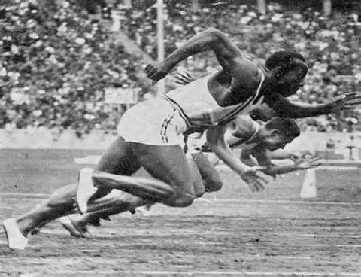
Jesse Owens
Owens was a track star during the Great Depression
In 1936 he went to Germany for the Olympics and won four Gold Medals
Germany was run by Adolf Hitler, who believed that Germans were superior over everyone else
Owens inspired Americans by showing the world that the Germans were not a superior group.
Click on the photo above to see a video of Jesse Owens at the 1936 Olympics

Slide 5
Questions??????
Why were the following famous during the Great Depression:
Duke Ellington
Margaret Mitchell
Jesse Owens
Why were they important to Americans during the Great Depression?
Notes:
They provided a source of entertainment and pride in America, provided a distraction to the hardships of the Great Depression

