Slide 2
Constructive Processes
Many of Earth’s surface features form due to constructive processes.
Constructive has the word _____________ in it, which means that these processes build up the Earth.
© LoveLearning 2014

Slide 3
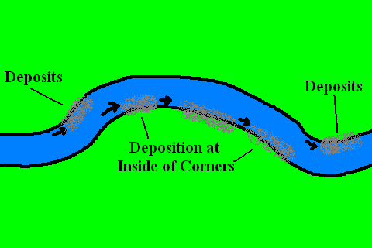
Deposition
Weathering breaks down rock
Erosion moves the rock from place to place
When wind and water slows down, it drops off some of that rock
© LoveLearning 2014

Slide 4
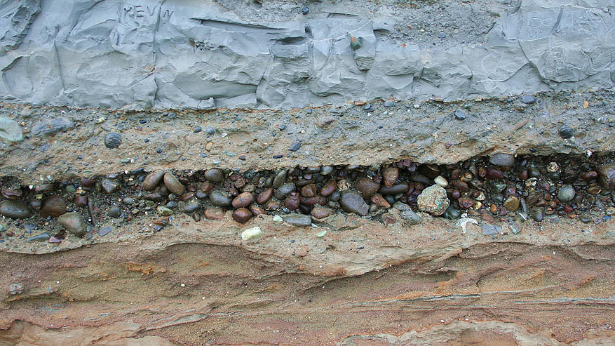
Deposition
Deposition: the dropping of sediment or particles by water, wind, or ice.
The deposited material is called sediment (a mix of rocks and sand)
© LoveLearning 2014

Slide 5
Deposition
Sediment is picked up in one place, carried somewhere else, and then deposited someplace else.
This helps to change the shape of rivers!
© LoveLearning 2014

Slide 6
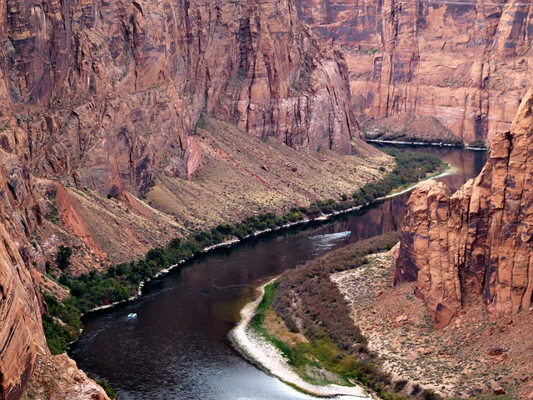

Slide 7
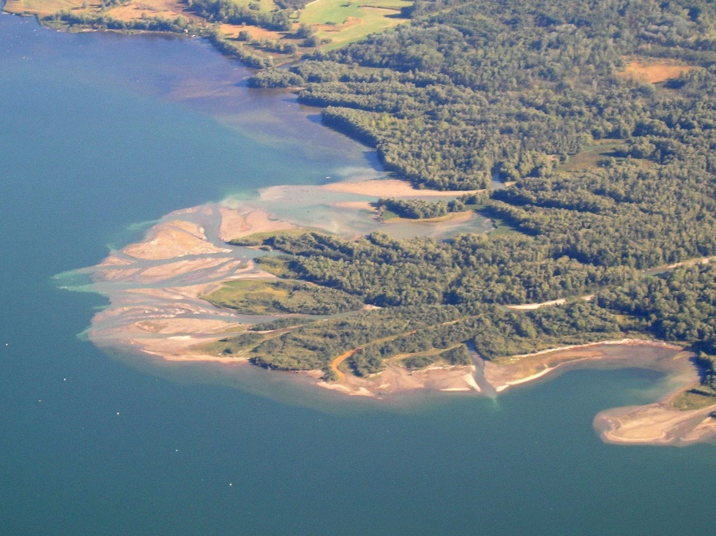
Deposition
The moving water in a river slows down near its mouth – the place where the river flows into the ocean or lake.
As the river slows down, sand and soil settle on the bottom
This builds up and forms a flat piece of land called a delta
http://www.onegeology.org/extra/kids/earthprocesses/deltas.html
© LoveLearning 2014

Slide 8
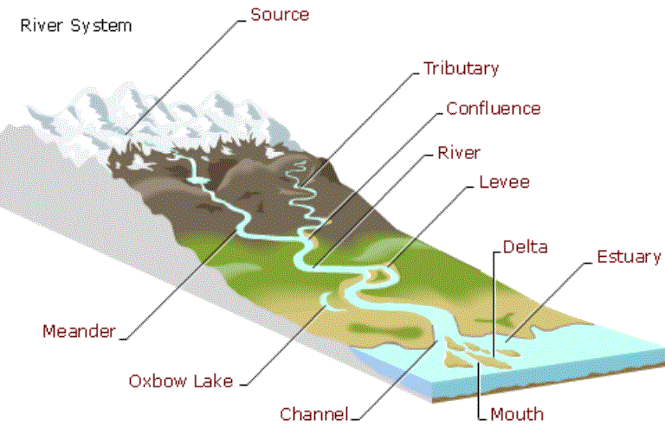
© LoveLearning 2014

Slide 9
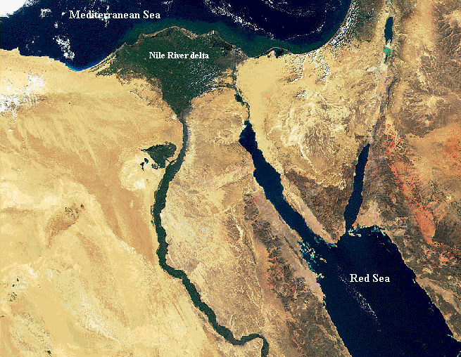
© LoveLearning 2014

Slide 10
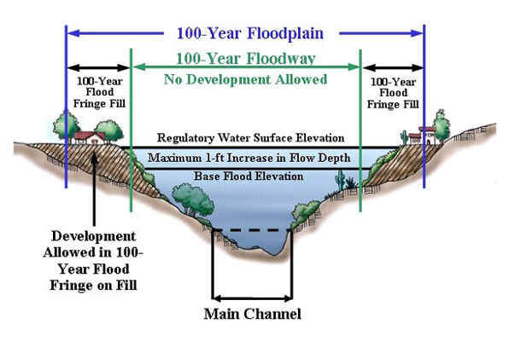
Deposition
When rainfall is very heavy, a river overflows
Water spreads over the land and deposits sediment
This sediment forms a wide, flat area called a floodplain
© LoveLearning 2014

Slide 11
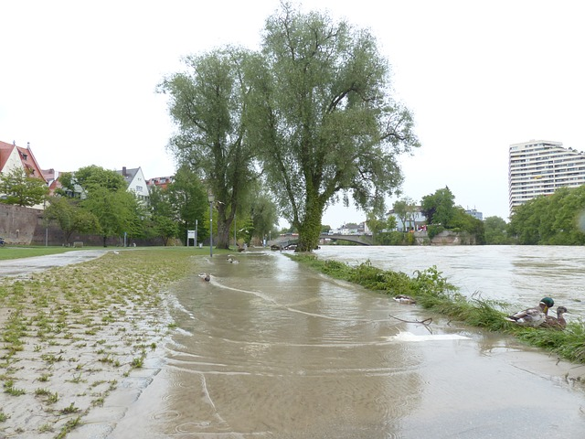

Slide 12
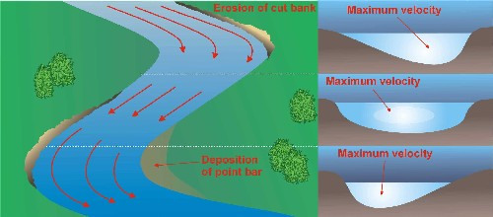
Water
Water is the main agent of deposition.
Rain washes sediment off the land into the rivers and then carries it along.
© LoveLearning 2014

Slide 13
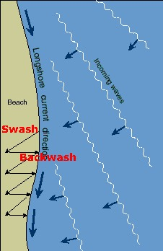
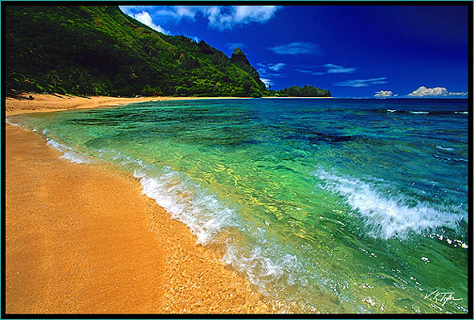
Beaches
Beaches: ocean currents and waves help to form these. Rivers carry sediment to the ocean and there the long shore currents sweep it along. The waves then wash sediment onto the shore to form beaches.
© LoveLearning 2014

Slide 14
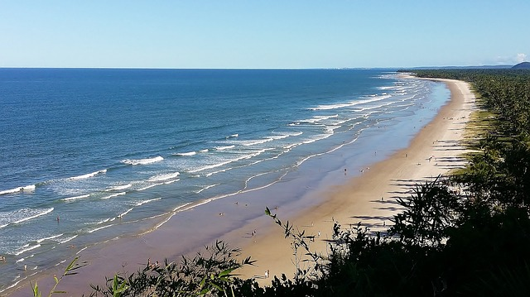

Slide 15
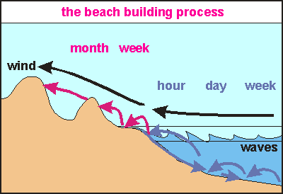
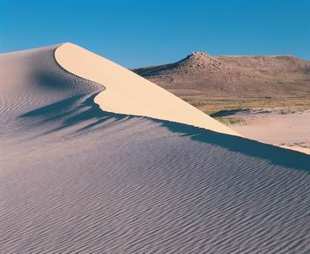
Wind
Wind is another agent of deposition.
Wind carriers sediment in desert areas. The soil is dry and the particles don’t stick together. There are few plants to hold the soil in place.
Sand Dunes: a mound of sand piled up by the wind.
© LoveLearning 2014

Slide 16
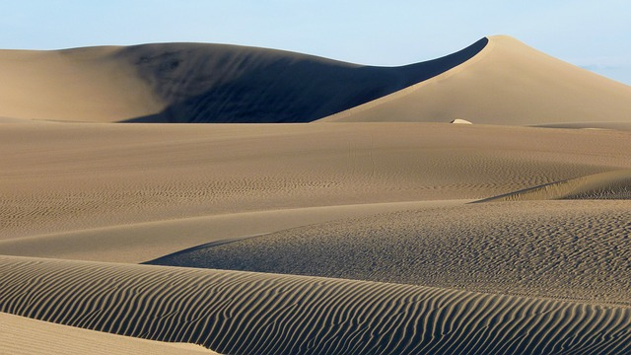

Slide 17
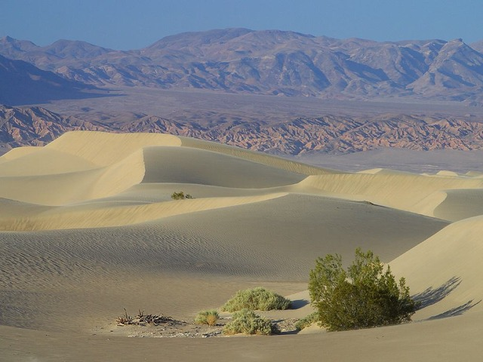

Slide 19
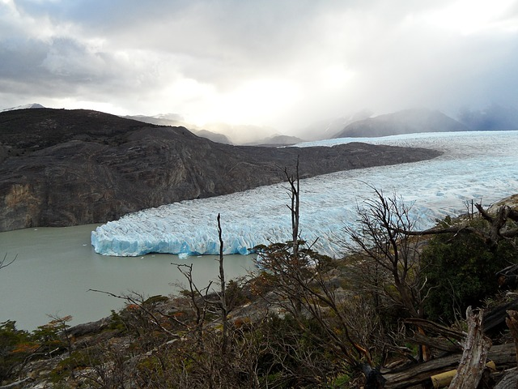

Slide 20
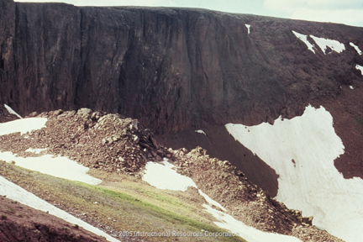
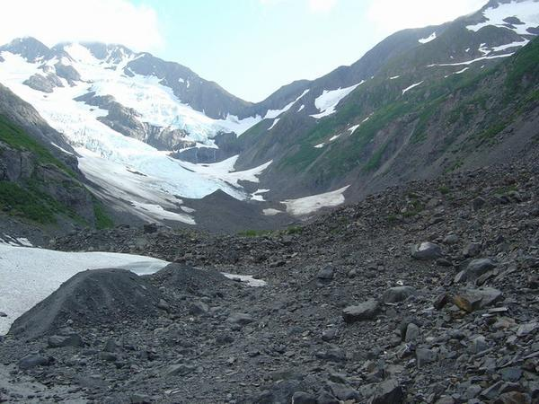
Moraines
Moraines: a ridge of sediment and rock left behind by a glacier.
http://www.brainpop.com/science/earthsystem/glaciers/
© LoveLearning 2014

Slide 21
Formation of a Glacier
http://safeshare.tv/w/PXphZCclfk
© LoveLearning 2014

Slide 22
Terms of Use
Thank you for downloading this product! The purchase of this product entitles you to single classroom use. Please be respectful of my work and do not share with your entire grade level or post this anywhere online (including your personal website). If you wish to share this with colleagues, please purchase multiple user licenses.
If you have any questions or need clarification, please contact me at lovelearningTPT@yahoo.com
Other science, social studies, common core math, and writing resources

Slide 23
Graphics From:
www.pixabay.com

