Slide 1
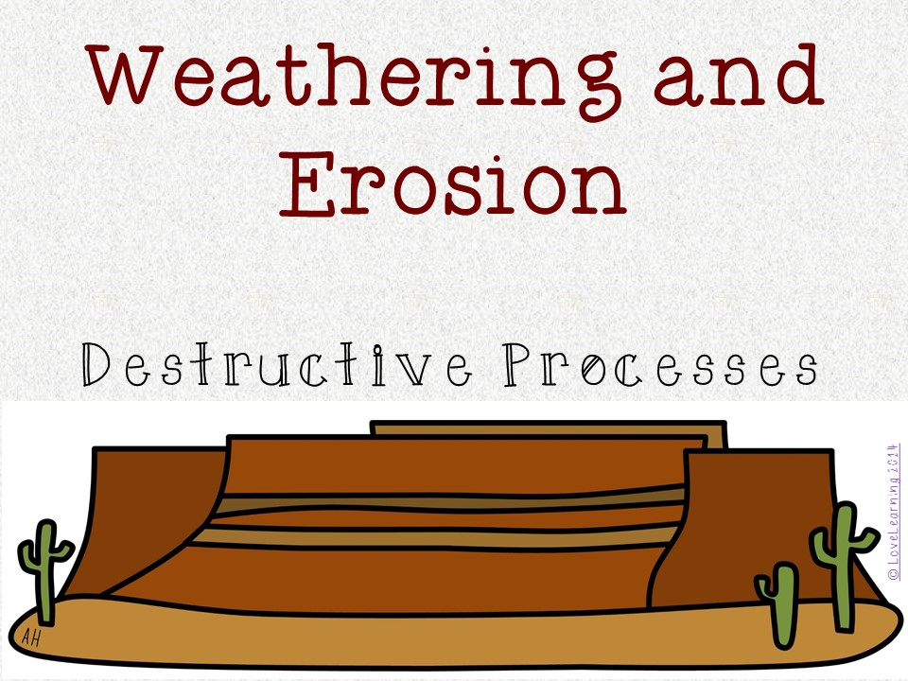

Slide 3
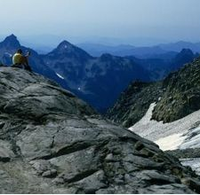
Weathering
The Earth’s surface is made up of mostly rock
Although rock is hard, wind and water can slowly break it apart
© LoveLearning 2014

Slide 4
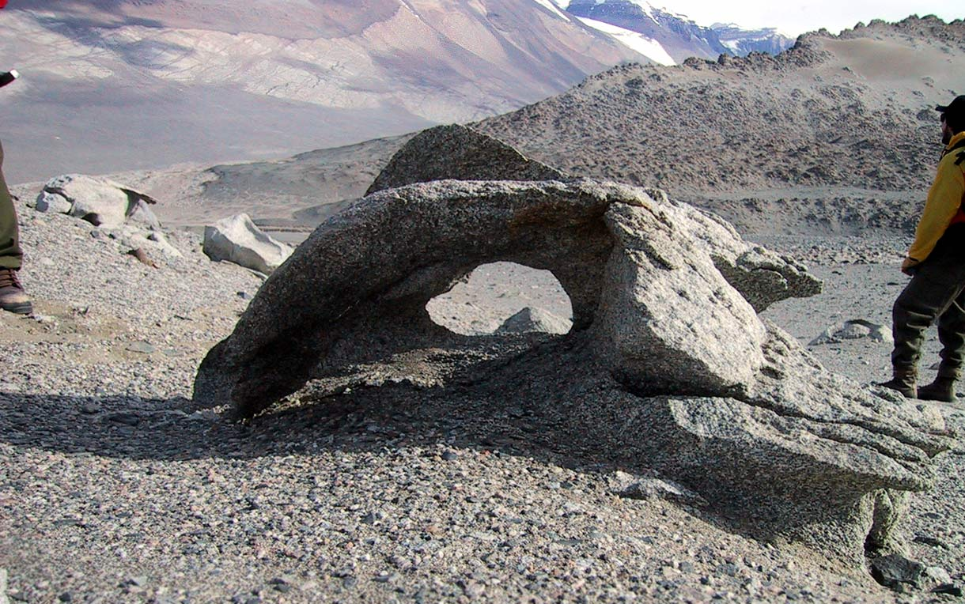
Weathering
Weathering: the breakdown of rock at or near Earth’s surface
© LoveLearning 2014

Slide 5
Weathering
Wind and water can carry sand and other small pieces of rock
Sandpaper makes wood smoother
Blowing sand acts like sandpaper
Ocean waves break down rock cliffs because the waves carry sand and pebbles
http://www.glencoe.com/sites/common_assets/science/virtual_labs/E06/E06.html
© LoveLearning 2014

Slide 6
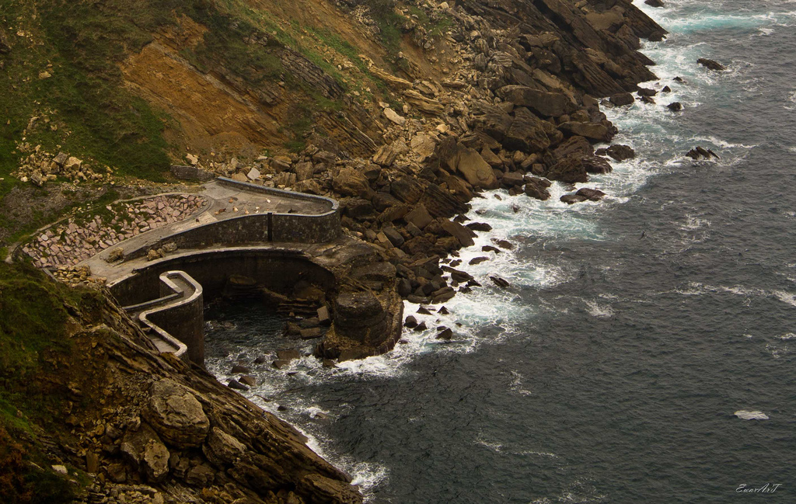

Slide 7
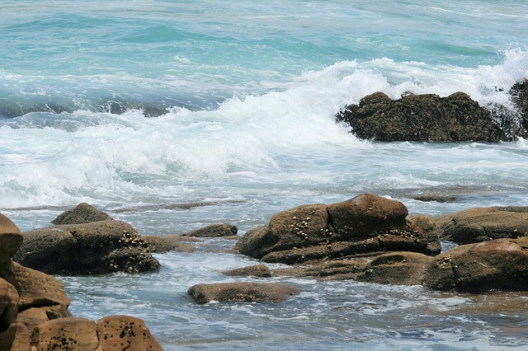

Slide 8
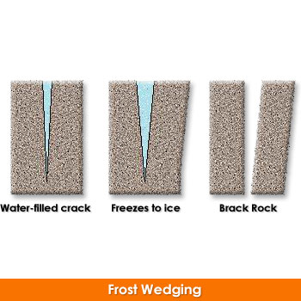
Weathering
Rain also causes weathering
Water seeps into the cracks of a rock
As the water freezes, the rock expands and cracks
When water freezes into ice, the ice expands and cracks the rock into wedges
As rocks freeze (contract) and heat up (expand), rocks break apart
© LoveLearning 2014
Notes:
Click on the title for an interactive site!

Slide 10
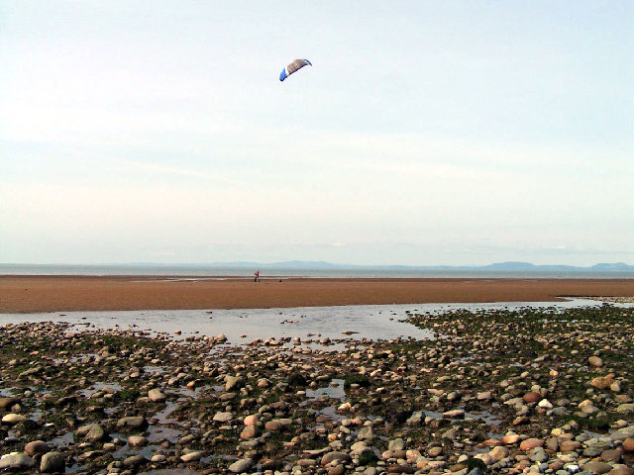
Weathering
Wind, water, and plants weather rock
The weathering breaks rock into smaller and smaller pieces over a long time
These pieces become pebbles and sand
Small pieces of rock along with material from living things make up soil
© LoveLearning 2014

Slide 11
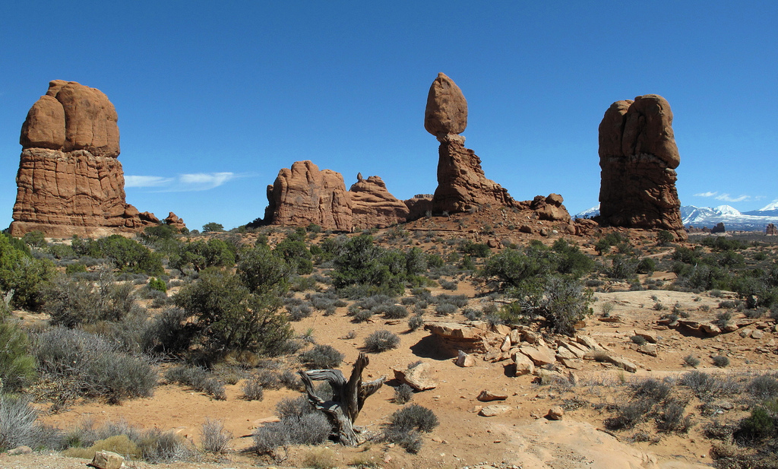

Slide 12
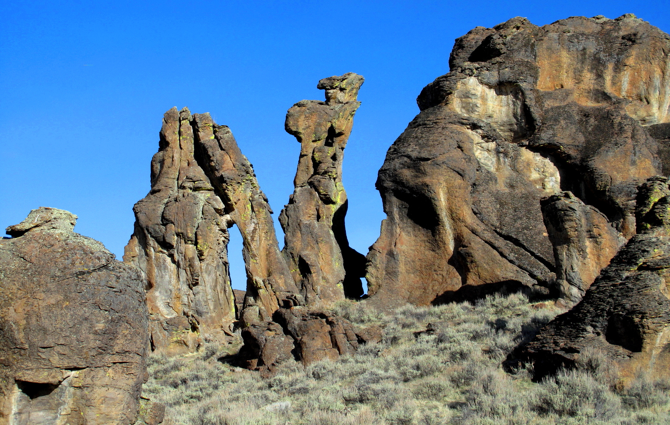

Slide 13
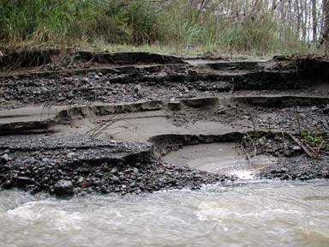
Erosion
After weathering breaks down rock into sediment (small pieces), erosion carries it away
Erosion: the movement of weathered rock from place to place
© LoveLearning 2014

Slide 14
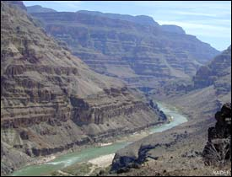
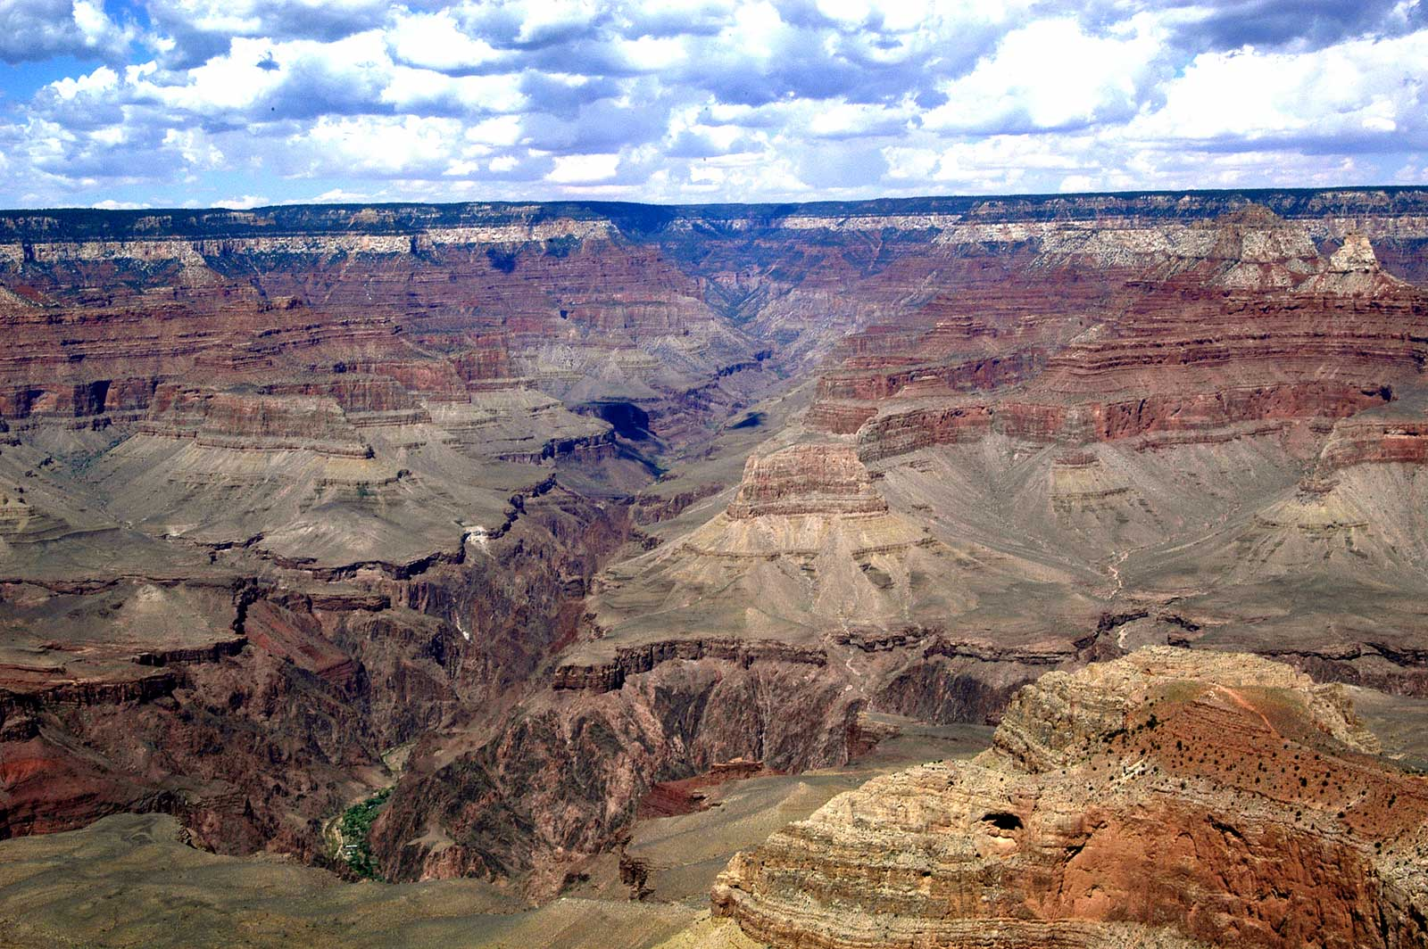
Erosion by Water
Rivers remove rock and soil and carry it away
This leaves channels and valleys in the soil
Over a long period of time, the Grand Canyon was formed because of the Colorado River!
© LoveLearning 2014

Slide 15
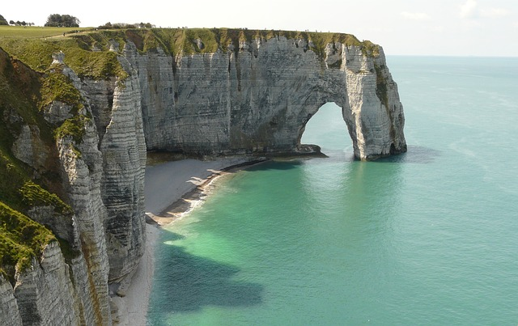
© LoveLearning 2014

Slide 17
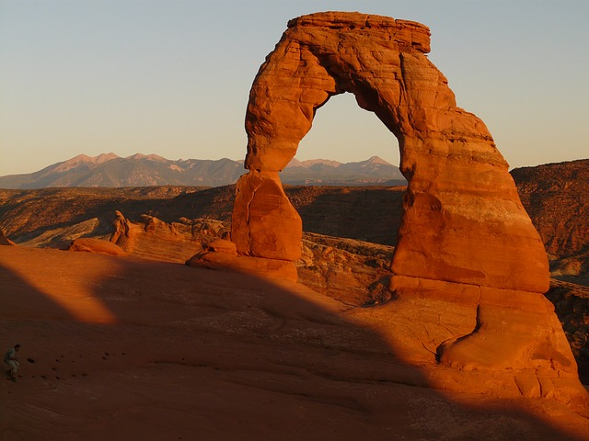

Slide 18
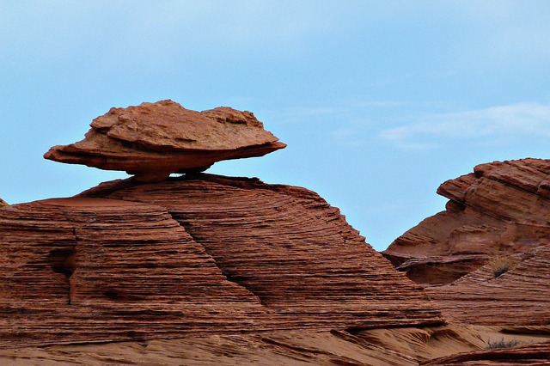

Slide 19
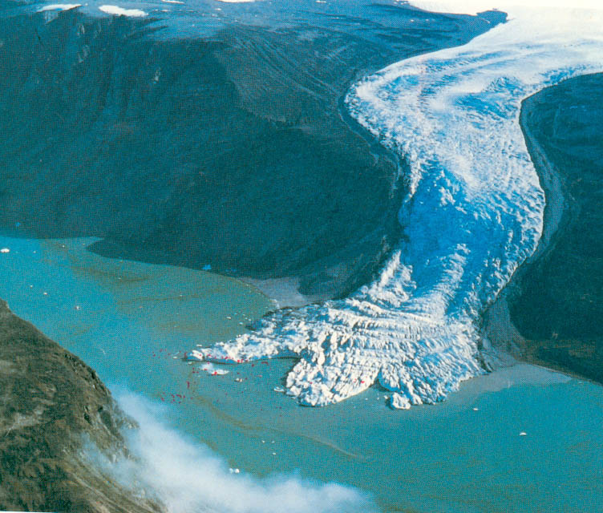
Erosion by Glaciers
Glacier: a large, slow-moving piece of ice
Glaciers erode rocks as they move across the Earth
© LoveLearning 2014

Slide 20
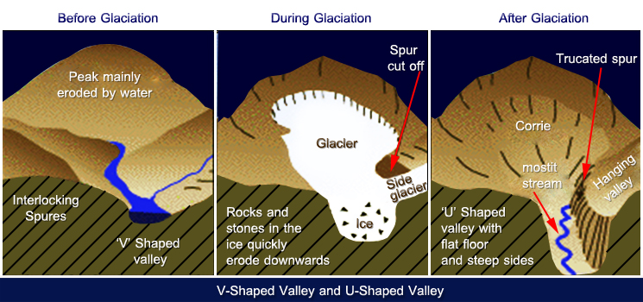
Erosion by Glaciers
Glaciers that pass through valleys widen and deepen the valley
Also scoop out holes in the ground (can later fill up with water)
© LoveLearning 2014

Slide 21
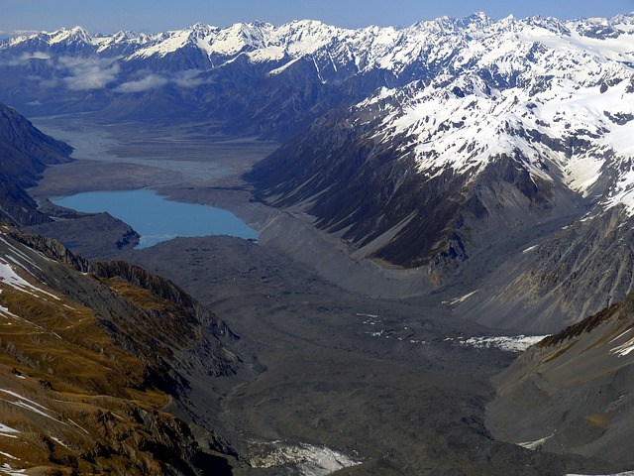

Slide 22
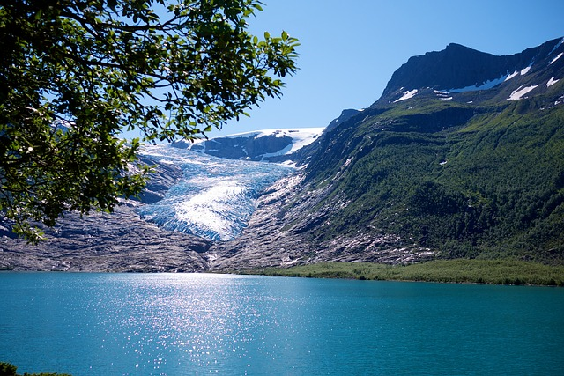
© LoveLearning 2014

Slide 23
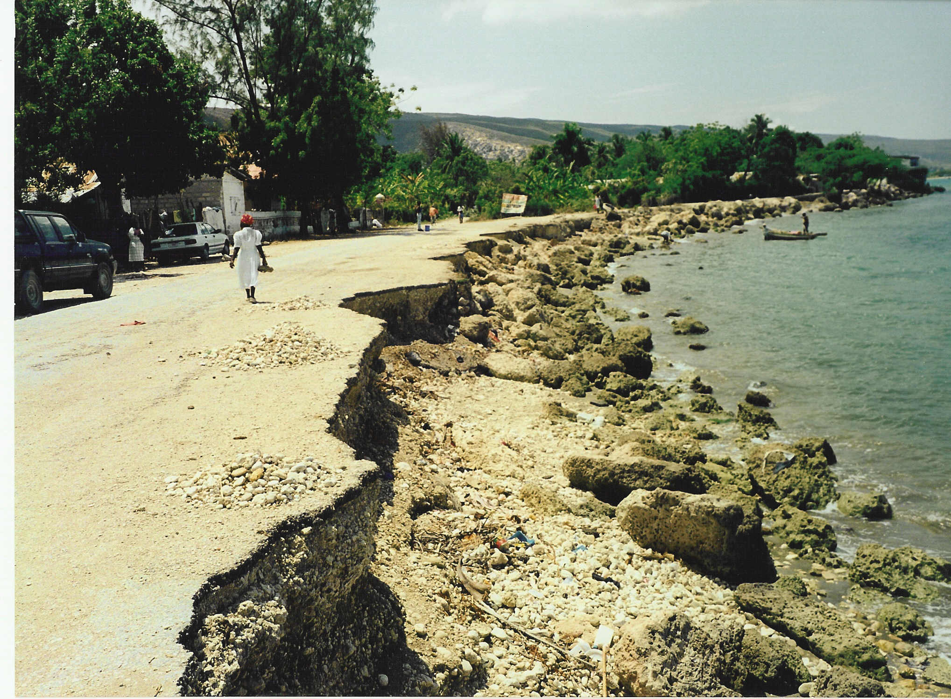
Erosion by Ocean Waves
As ocean waves hit the shore, they can deposit sand and form beaches
They can also remove sand from the beaches
© LoveLearning 2014

Slide 24
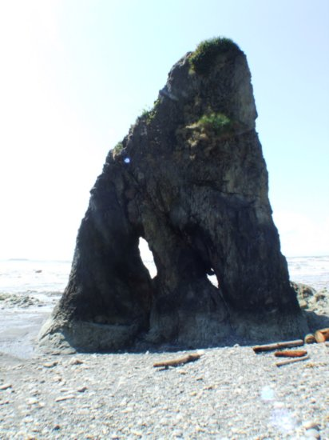
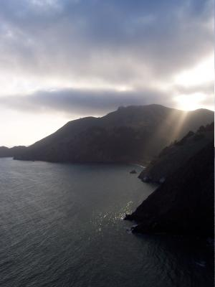
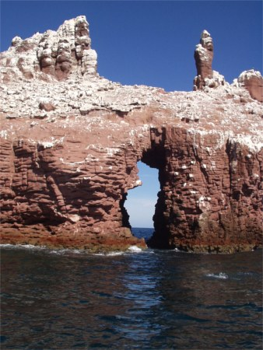
Erosion by Ocean Waves
Waves also pound against landforms and break down rock cliffs
These cliffs can form new landforms
© LoveLearning 2014

Slide 25
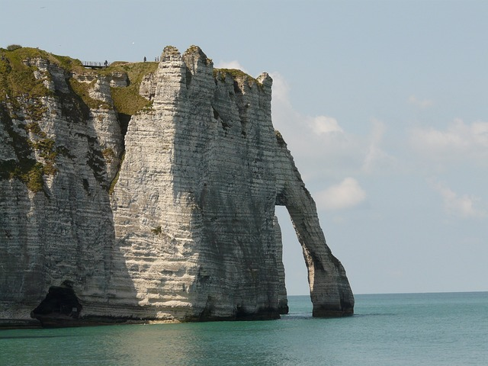

Slide 26
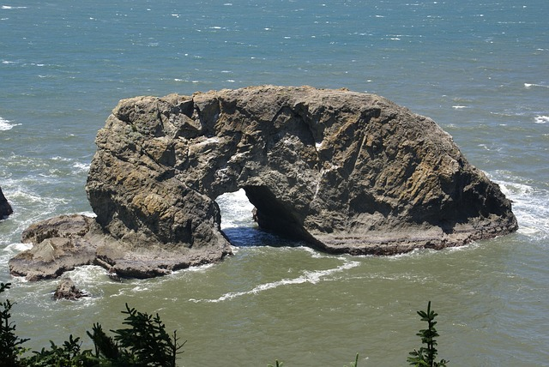

Slide 28
Erosion – Extra Links
http://sciencenetlinks.com/media/filer/2011/10/07/forces.swf
http://www.classzone.com/books/earth_science/terc/content/visualizations/es1205/es1205page01.cfm?chapter_no=visualization
http://www.brainpop.com/science/earthsystem/erosion/
http://studyjams.scholastic.com/studyjams/jams/science/rocks-minerals-landforms/landforms.htm
© LoveLearning 2014

Slide 29
Erosion – Bill Nye the Science Guy Video
© LoveLearning 2014

Slide 30
Terms of Use
Thank you for downloading this product! The purchase of this product entitles you to single classroom use. Please be respectful of my work and do not share with your entire grade level or post this anywhere online (including your personal website). If you wish to share this with colleagues, please purchase multiple user licenses.
If you have any questions or need clarification, please contact me at lovelearningTPT@yahoo.com
Other science, social studies, common core math, and writing resources

Slide 31
Graphics From:
www.pixabay.com

