Slide 1
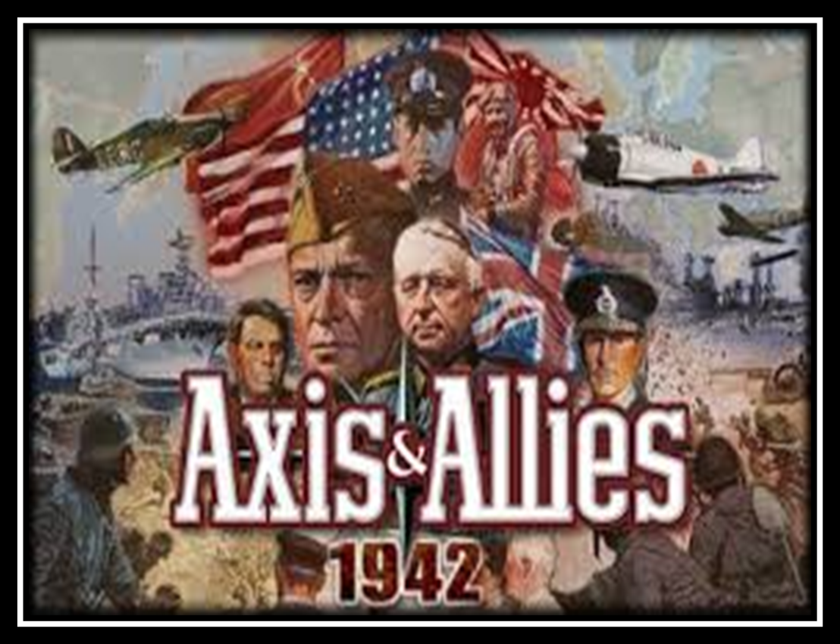
World War II
By: Cammie Goodman

Slide 2
Germany lost World War I and like the U.S., suffered a deep economic depression.
Germans wanted a strong leader and they elected the Nazi Party to power in 1932.
Adolf Hitler was made chancellor in January, 1933 and became dictator in March of that year.

Slide 3
Hitler blamed the problems of Germany on innocent people.
He said “true” or “Aryan” Germans were the smartest and most powerful people and would soon rule the world.
Most of the people Hitler called “true’ Germans liked him at first and they supported the Nazi Party because they believed Hitler would make Germans powerful again.

Slide 4
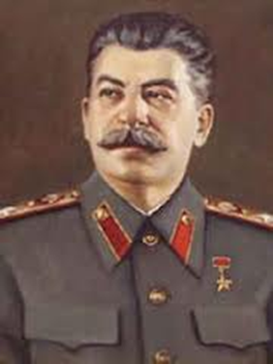
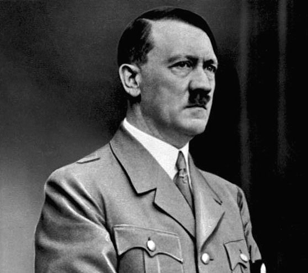
World War II Begins
In 1939, Germany invaded Czechoslovakia and then Poland.
Hitler and Joseph Stalin, leader of the Soviet Union, signed a secret treaty.

Slide 5
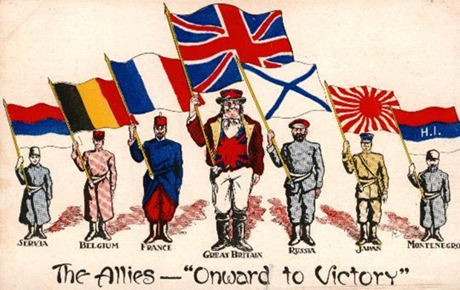
The Soviets did not want to fight the Germans.
However, many countries joined together to fight Hitler.
France, Great Britain, Austria, New Zealand, South Africa, and Canada declared war on Germany in 1939.
India did not formally declare war, but their army played an important role.
These countries called themselves the Allied powers.

Slide 6
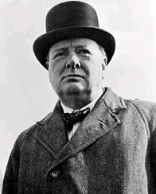
At this time there was a war in Asia.
In 1937, Japan invaded China.
Germany invaded France on May 10, 1940.
On that same day, Winston Churchill became Prime Minister of Great Britain.

Slide 7
Germany, Italy and Japan joined together and called themselves the Axis powers.

Slide 9
From 1940-1941:
The Axis powers invaded more countries.
Germany invaded the Soviet Union, Denmark, Norway, France, Belgium, the Netherlands, Luxembourg, Hungary, Yugoslavia, Greece and Romania.
The Soviet Union joined the Allies.

Slide 10
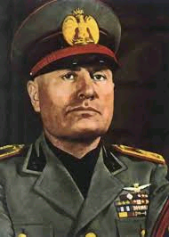
Italy’s leader, Benito Mussolini, with Germany, invaded countries around the Mediterranean Sea.
Japan invaded French –controlled Vietnam.
France was Great Britain’s ally.

Slide 11
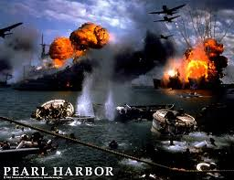
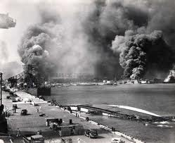
Pearl Harbor
On December 7, 1941 the Japanese bombed the American naval base at Pearl Harbor, in Hawaii.
12 warships and 188 airplanes were destroyed.
More than 2,000 people were killed.

Slide 12
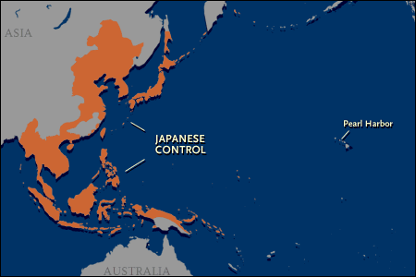
Japan also attacked Hong Kong, Shanghai, the Philippines, Thailand, Guam, and Malaya, which had generally been controlled by the U.S. and its allies.

Slide 13
www.educationdiscovery.com
Only show the FDR segment

Slide 14
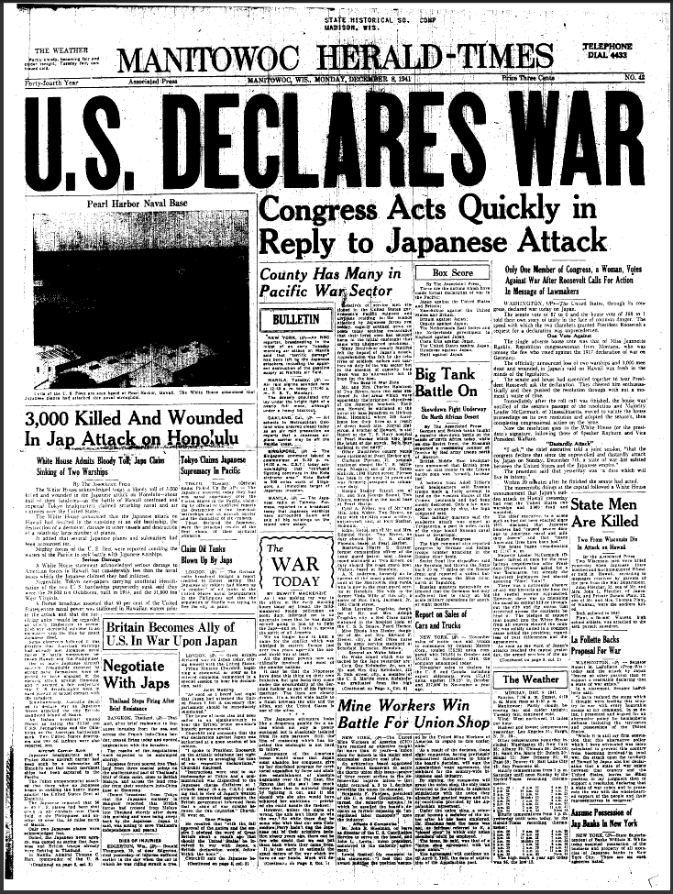
Pearl Harbor
After the attacks, the U.S. declared war on Japan and joined the allies.
World War II ended the Great Depression.
Many women worked in factories making tools for the war.

Slide 15
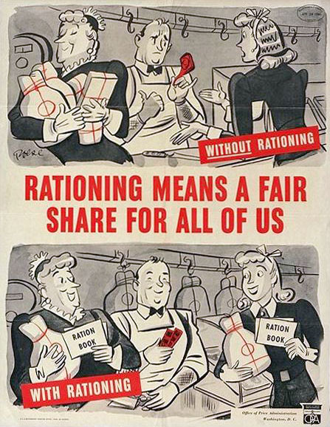
Consumer goods were rationed- the government limited what a family could buy.
Anything not crucial to survival was hard to get.
Butter, sugar, and meat were in short supply.

Slide 16
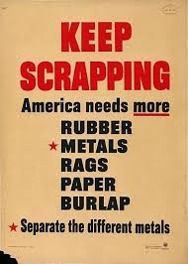
All agriculture, factories, and workers needed to fight the war.
Many people collected scrap metal for making weapons.
They also grew their own fruits and vegetables in victory gardens to have fresh food to eat.

Slide 17
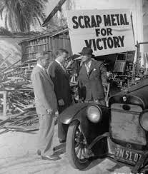
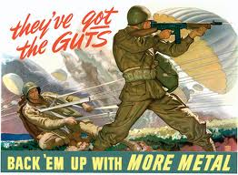
Scrap Drives

Slide 18
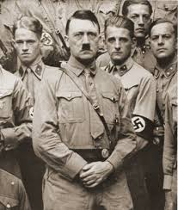
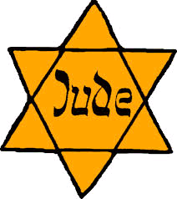
The Holocaust
Hitler took away the rights of all Jews in Germany and in the countries it defeated.
They had to wear yellow stars as identification.

Slide 19
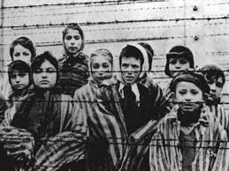
The Holocaust
In 1938, in Germany, the Nazi’s burned down Jewish temples and vandalized their businesses.
Thousands were sent to concentration camps.

Slide 20
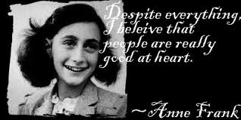
The Holocaust
Soon Hitler’s Nazi government began killing Jews, gypsies, and the disabled.
These people tried to hide, but they were usually found.
These events were known as the Holocaust.

Slide 21
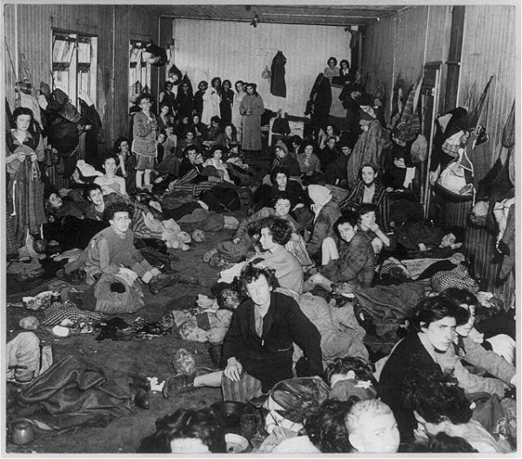
The Holocaust
These groups of people, as well as people who tried to help them, were sent to concentration camps in Germany, Poland, and other Nazi territoires.
At the camps, they were gassed, shot, hanged, or worked and starved to death. Many died of disease.
Almost 6 million jews and 5 million other civilians were killed by the Nazi in the Holocaust.

Slide 22
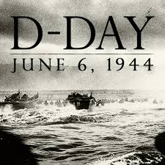
D-Day
On June 6, 1944, Allied forces launched the largest sea attack in history.
160,000 troops or soldiers, crossed the English Channel in ships and planes landed on the beaches of Normandy France.
This was called D-Day.
American General Dwight Eisenhower led the surprise attack.
It was a huge battle and thousands of people on both sides died as the fight moved through France.

Slide 23
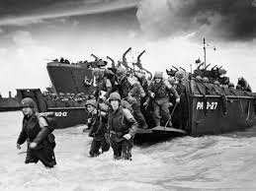
D-Day

Slide 24
www.educationdiscovery.com

Slide 25
On August 25, 194, the Allied troops reached Paris, liberating it from the Nazis.
The Allied troops fought the Nazis throughout Europe.
They liberated, or freed, prisoners in Nazi concentration camps.
Military and government leaders had heard of the camps, but the stories had seemed too terrible to be true.
When Allied troops saw the concentration camps, they were horrified.

Slide 26
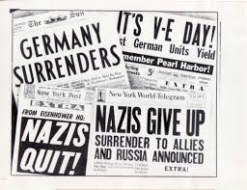
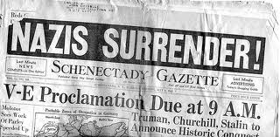
The war in Europe ended in May 1945.
V-E Day (Victory in Europe Day) was May 7, 1945.
The Nazis had surrendered.
Hitler killed himself so he wouldn’t be captured.
Nazi Germany collapsed.

Slide 28
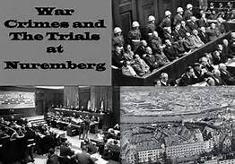
Nazi leaders were put on trial for their role in the Holocaust. This was called the Nuremberg war crimes trials.
Ten German leaders were hanged, seven given prison sentences.
Other leaders were tried or sentenced later.

Slide 29
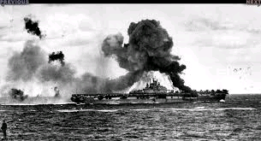
The War in the Pacific
By the end of 1942, the Japanese controlled much of East Asia and many islands in the Pacific Ocean.
The Japanese way of fighting came as a surprise to Allied forces.
The Japanese would crash their warplanes into Allied ships in Kamikaze attacks. Kamikaze means divine wind.

Slide 30
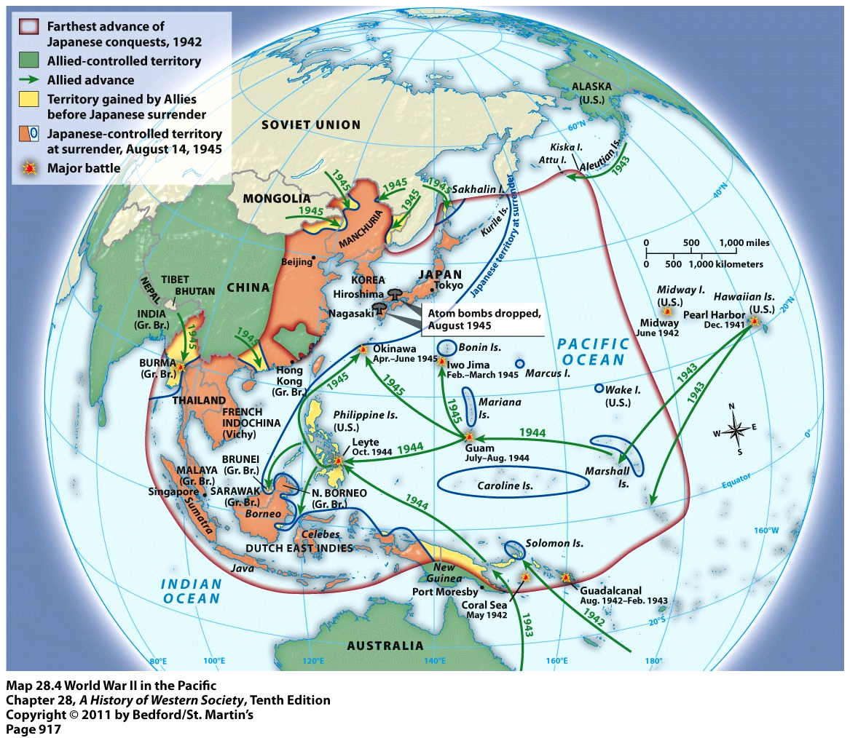

Slide 31
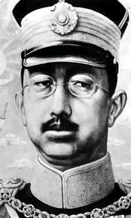
Like the Nazis, the Japanese militarists believed the Japanese were the best, smartest and strongest
The Japanese people worshiped their leader, Emperor Hirohito.
They believed that he was a god.

Slide 32
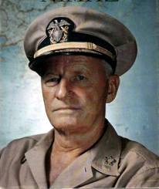
Admiral Chester Nimitz led the Allied navy in the Pacific.
He fought the Japanese by island hopping.- The Allies blocked islands so the Japanese could not bring in food or troops.
Nimitz captured the islands of Iwo Jima and Okinawa.

Slide 33
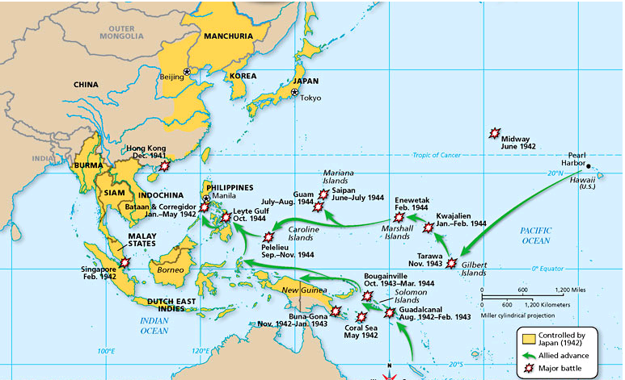

Slide 34
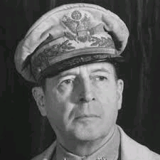
General Douglas MacArthur was the Supreme Commander of the Southwest Pacific.
Under his command, the Allies took back the Philippines.
The Japanese were losing, but they would not surrender.

Slide 35
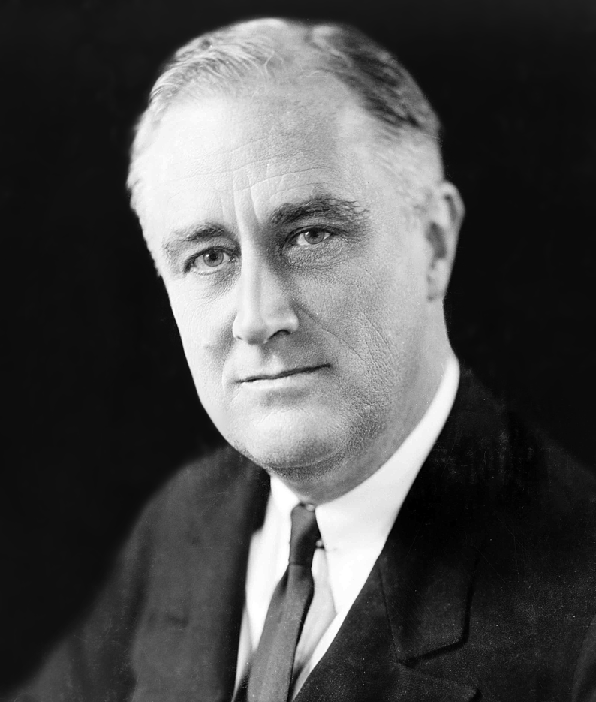
In April 1945, President Roosevelt died and so Vice President Harry S. Truman became President.

Slide 36
Truman decided to end the war by dropping the first Atomic Bomb on Hiroshima, Japan.
It killed about 140,000 people, mostly civilians.
Three days later, a second atomic bomb was dropped on Nagasaki, Japan.
It killed 75,000 civilians.

Slide 37
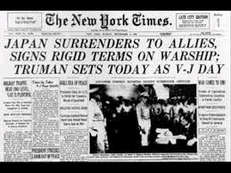
The Japanese agreed to surrender terms on August 15, 1945.
World War II was over.
World War II caused many changes in America.
V-J Day (Victory over Japan Day) was September 2, 1945, when the Japanese formally surrendered.
General Mac Arthur accepted the surrender on board the USS Missouri in Tokyo Bay on that day.

Slide 38
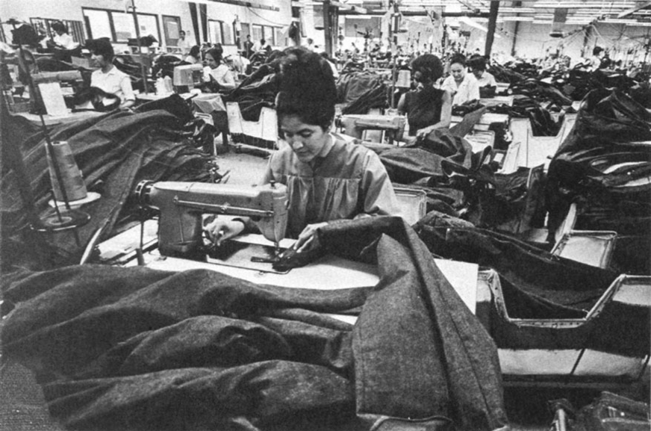
Changing Roles in Society
Women’s Roles:
Low-income women worked in sweatshops and other factories so they could support themselves and others.

Slide 39
Before the war, middle-class women did not have jobs. They were expected to stay at home and raise families.
During the war, they took all sorts of jobs, including physical labor in factories

Slide 40
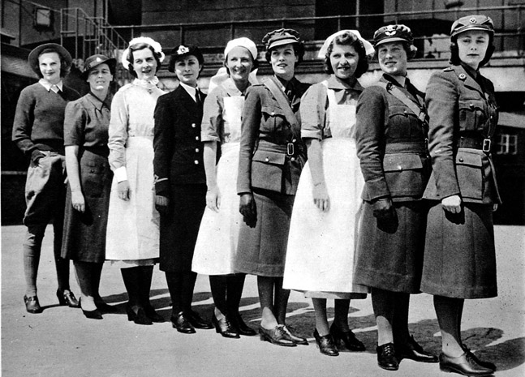
After the war, many of the women wanted to keep their jobs.
Soldiers came home from the war and took back their jobs.
Women then found jobs as teachers, nurses, and other work more open to women.
More and more women entered the workforce.

Slide 41
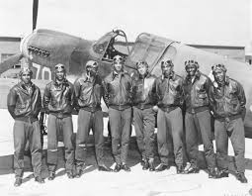
Tuskegee Airmen
The Tuskegee Airmen were African American pilots who fought with 332nd Fighter Group of the U.S. Army Air Corps in the World War II.
They were the first African American pilots in the U.S. military.
In 1941, Congress had to force the segregated military to allow African Americans to fly airplanes.

Slide 42
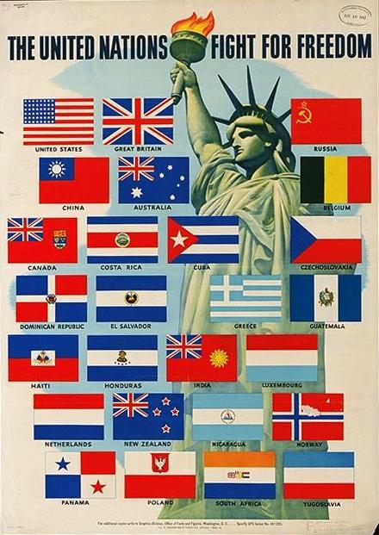
United Nations
The “United Nations” was the name given to the 26 Allied nations by their representatives at a conference in 1942.
They wanted to make sure that a war like World War II never happened again.
The leading nations in the group were China, the Soviet Union, the United Kingdom, and the United States.

Slide 43
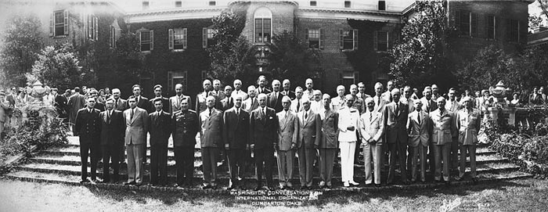
United Nations:
Representative of those nations had met at Dumbarton Oaks in Washington, D.C. in the fall of 1944.
When China, France, the Soviet Union, the UK, the U.S. and many other countries agreed, the United Nations began on October 24, 19445.
Today the United Nations is involved in negotiating peace and war around the globe.

Slide 44
Allies Powers | Leaders
Axis Powers | Leaders
Great Britain
Winston Churchill, Prime Minister
France
Charles de Gaulle
(not under German control)
Soviet Union
Joseph Stalin, Communist Dictator
United States
Franklin D. Roosevelt, President
Germany
Adolf Hitler, Nazi dictator
Italy
Benito Mussolini, Fascist dictator
Japan

Slide 45
www.educationdiscovery.com

Slide 46
Vocabulary Words to Know
Nazi Party- totalitarian socialist party in Germany led by Adolf Hitler.
Allied Powers- countries that fought the Axis powers. France, Great Britain, Australia, New Zealand, South Africa, Canada, and U.S.
Axis Powers- Germany, Italy and Japan.
Pearl Harbor- the surprise attack by Japan on Dec. 7, 1941 that caused the U .S. to enter WW II.

Slide 47
5.Rationed- allocate scarce supplies, usually by government orders, to provide equal distribution of a product, usually to conserve resources.
6.Holocaust –the term used for the systematic killing o Jews, gypsies, the disabled, and many others in WW II Germany by the Nazis.
7.Concentration Camps- during WWII, where the Nazis sent people, mostly Jewish to be killed by gassing, shootings or hangings.
8.D-Day- the day that allied forced invaded Nazi Europe by entering Normandy France, leading to the end of WWII.

Slide 48
9. Liberated- to make free.
10. V-E Day- (Victory in Europe Day) the day that German forces surrendered to the Allies in Europe.
11. Nuremberg war crime trials- series of trials of 24 Nazi Leaders
12. Kamikaze- Japanese pilot trained in WWII to crash into Allied ships.
13. Island hopping- World War II war strategy used in the Pacific
14. Atomic bomb-bomb that gets it destructive power from the release of nuclear energy.
15. V-J Day – (Victory over Japan Day) the day that Japanese forces surrendered to the Allies in Japan.
16. Tuskegee Airmen- Group of African American pilots during WWII.

