Slide 1
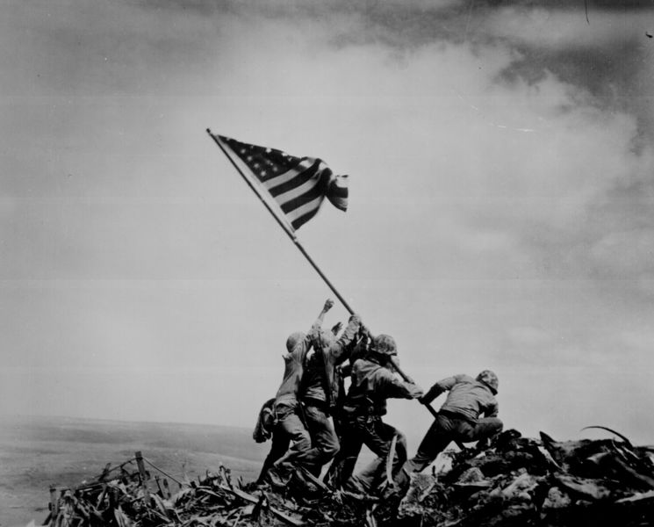
WWII 1933-1945
Fifth Grade Social Studies

Slide 2
Important Terms
Dictator-a leader who gains complete control of a country’s government
Fascism-a form of government in which individual freedoms are denied and complete power is given to the government
Axis-Germany, Italy, and Japan
Allies-Great Britain, France, Soviet Union, Canada, USA
Rationing-a limit on the amount of food each person in the USA could buy
Atomic bomb-extremely powerful bombs that create massive, explosive energy by splitting atoms

Slide 3
Important People
Franklin D. Roosevelt-32nd President from 1933-1945
Adolf Hitler-dictator of Germany from 1933-1945
Benito Mussolini-the founder of Fascism and leader of Italy from 1922 to 1943
Winston Churchill-Prime Minister of Great Britain from 1940-1945
Hideki Tojo-Prime Minister of Japan from 1941-1944
Joseph Stalin-Supreme Ruler of the Soviet Union from 1922-1953
Benjamin O. Davis Jr.-One of the first African American US fighter pilots
Albert Einstein-a Jewish scientist who escaped Germany to the USA
George S. Patton-American General who led allies to victory
Douglas MacArthur-American General who led fight against Japan
Harry S. Truman-became President after Roosevelt’s death in 1945 and made the decision to use the atomic bomb on Japan
Hirohito-Emperor of Japan from 1926-1989

Slide 4
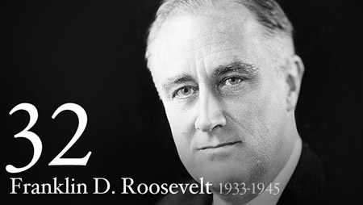
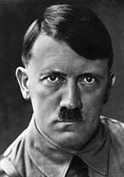
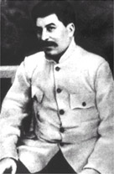
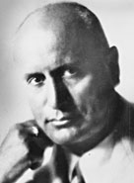
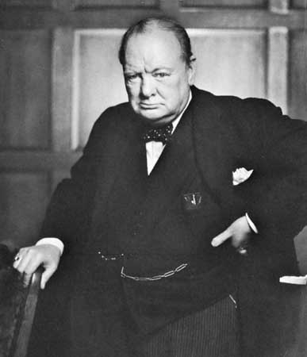
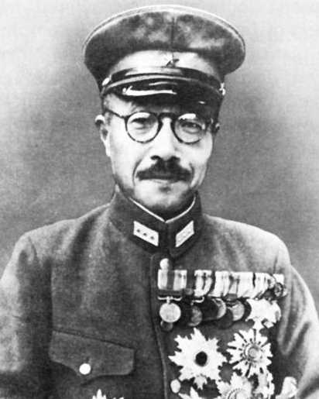
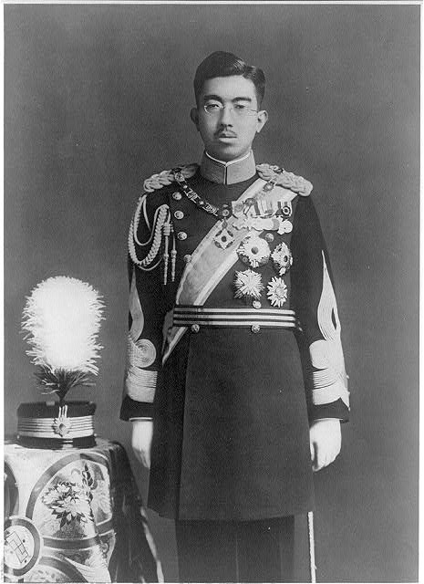

Slide 5
Important Places and Events
Pearl Harbor, Hawaii-American Naval Base bombed by the Japanese on December 7, 1941 which was the catalyst for the USA to join the allies on December 8th
“Rosie the Riveter”-a symbol for women during the war because of their efforts in war defense industries and combat
Tuskegee Airmen-sent to fight in 1943 as the first African American fighter pilot corp
Iwo Jima, Japan-small Pacific island invaded by the US in February 1945
Manhattan Project-code name given for the effort to build the atomic bomb
Hiroshima, Japan-first atomic bomb dropped on August 6, 1945
Nagaskai, Japan-second atomic bomb dropped three days later
Holocaust-name given to the 6 million Jews murdered by Nazis during WWII

Slide 6
Overview of WWII
In the 1930s, dictators like Adolf Hitler of Germany and Benito Mussolini of Italy promised to expand their countries’ borders through invasion.
Also during this time, Japan decided to create a massive empire in East Asia through invasion.
In 1936, Hitler and Mussolini signed a treaty agreeing to support each other. Japan joined this alliance. The powers became known as the Axis.
After invading Ethiopia, Austria, Czechoslovakia, and China, German forces invaded Poland. In 1939, the countries of Britain and France decided to stop Hitler. The countries declared war on Germany, and WWII begun.
Britain and France became known as the Allied Powers.
German forces were successful in the early years of the war, and France fell to the Germans in June 1940.
Winston Churchill urged President Roosevelt to help Britain, but most Americans still remembered WWI and felt that the government should deal with problems at home first.

Slide 7
Continued
The USA helped Britain by sending money and supplies to support the country’s efforts. This expansion of US factories and goods helped to end the depression.
On December 7, 1941, General Hideki Tojo of Japan ordered the attack on Pearl Harbor US Naval Base.
2,300 Americans were killed during the attack.
After the attack on Pearl Harbor, 100,000 Japanese Americans were relocated into camps because of unwarranted threats to national security.
The US was not prepared for war and had to enact the draft to supply 10 million men into the military.
Women once again began working in tradition “male” jobs building supplies for the war effort. Women were also allowed to join the military. “Rosie the Riveter” became a symbol for women.
All Americans were asked to help the war effort through rationing.
In 1942, The United States government began the Manhattan Project as a secret effort to build and atomic bomb before the Germans.
The Tuskegee Airmen were given the right to fly missions over North Africa and Europe in 1943.
Hitler broke an agreement with Joseph Stalin of the Soviet Union, and in June 1941, the Soviet Union joined the Allied Powers to fight Germany.

Slide 8
Major Turning Points in the War
The Battle of Midway stopped Japan from capturing islands in the Pacific.
The Battle of Stalingrad forced the Germans to retreat from the Soviet union.
On June 6, 1944, Allied forces landed on the coast of Normandy, France. The invasion became known as D-Day.
In December 1944, the Germans made a final attack on Allied forces. This attack is called the Battle of the Bulge because it was the biggest battle fought by the United States Army.
On May 8, 1945, Germany surrendered to Soviet forces in Berlin. This date is known as V-E Day for Victory in Europe.

Slide 9
Continued
In February 1945, the US Marines invaded the island of Iwo Jima, Japan. The Japanese were defeated in Okinawa.
On April 12, 1945, President Roosevelt died.
In July 1945, President Truman was told that American scientists had successfully tested the world’s first atomic bomb. He had to make the decision of whether to use the bomb against Japan or not.
On August 6, 1945, the atomic bomb was dropped on Hiroshima, Japan. 80,000 people were killed in just a few seconds.
Three days later, a second bomb was dropped on Nagasaki, Japan. 60,000 people were killed.
On August 14, 1945, Japan surrendered. This day is called V-J day for Victory in Japan

Slide 10
Germany During WWII
Hitler’s Nazi party had strict anti-Semitic policies. Anti-Semitic means hatred of Jews.
Jews were unwelcomed and persecuted.
Many Jews were taken to concentration camps where they were imprisoned with little chance of survival.
This time is called the Holocaust which means widespread destruction.
6 million Jews were murdered during the Holocaust.
About 6 million prisoners of war, Catholics, handicap people, and politicians were murdered.
Between 40-50 million people died during WWII.

